Slide 1
Introduction to Object Oriented Design

Slide 2
Topics
Designing Your Own Classes
Attributes and Behaviors
Class Diagrams

Slide 3
Objectives
At the completion of this topic, students should be able to:
Design classes for use in a C# program
Explain the difference between a class and an object
Explain what attributes and behaviors are
Explain the terms encapsulation and data hiding
Create accurate class diagrams using UML

Slide 4
Motivation

Slide 5
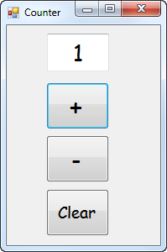
Consider the following simple program

Slide 6
Press this button
to add 1 to the
counter

Slide 7
Press this button
to subtract 1 from
the counter

Slide 8
Press this button
to reset the
count to zero.

Slide 9
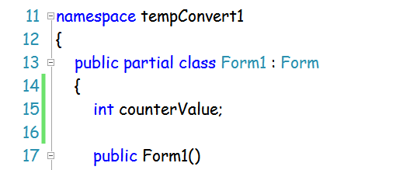
To make the counter work, we have to
Declare a variable to hold the value of the counter.
This variable must be visible to all methods in the Form.

Slide 10
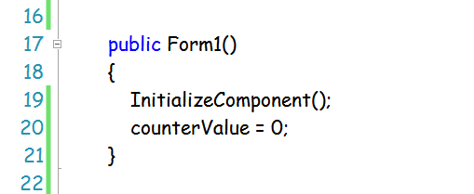
To make the counter work, we have to
(2) In the Form constructor, set this value to zero.

Slide 11
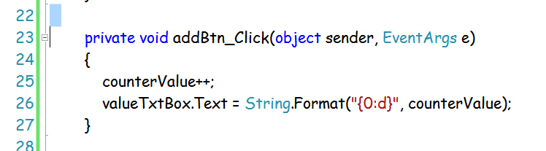
To make the counter work, we have to
(3) Write methods for each button, for example

Slide 12
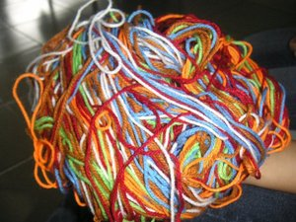
The Problem!
The user interface code gets all tangled
up with the “business logic” of the program.
This makes the code hard to maintain, hard
to debug, and makes the code hard to re-use.

Slide 13
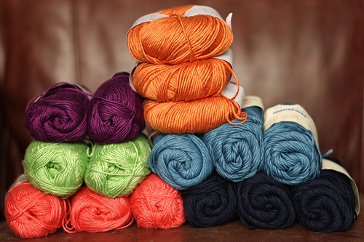
To solve this problem, good programmers
keep everything in neat, separate piles.

Slide 14
To solve this problem, good programmers
keep everything in neat, separate piles.
User
interface
code
Business
logic

Slide 15
The User Interface code belongs in the Form.
It’s main tasks are to display information to
the user, and to get input from the user.

Slide 16
We need a way of packaging up the application’s
data and the methods that operate on the data
in one unit, so that the data is visible to all of the
methods that will work on it, but keep it separate
from the user interface logic.
We can, if we use objects!

Slide 17
Objects

Slide 18
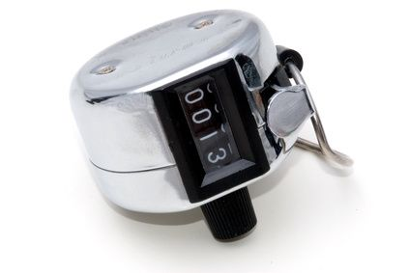
Key Concept
An object often models things in the real world
A counter

Slide 19
Real world objects have attributes
An object’s attributes describe its
“state of being”
depending upon the application, some attributes
are more important than others
size
color
value

Slide 20
Real world objects have attributes
An object’s attributes describe its
“state of being”
For our application, we are interested in
value

Slide 21
An object also has behaviors
behaviors define how you interact with the object
Add one to the counter
Subtract one from
The counter
Get the current value
of the counter
Reset the counter
To zero

Slide 22
An Object’s Attributes and Behaviors Should Work Together
this is called cohesion

Slide 23
An Object’s Attributes and Behaviors Should Work Together
This object has strong cohesion, because
all of the operations work on the single
data value in the counter, it’s value.

Slide 24
A Class is a blueprint that a program
uses when it creates an object.
A class reserves no space in memory
When an object is created from the class
blueprint, memory is reserved to hold the
object’s attributes.
An object is known as an instance of the class.
Each object has it’s own space for data.

Slide 25
A class is said to be an abstraction of the
real world object that we are modeling.

Slide 26
Encapsulation
Counter object
Add( )
calling method
member methods are
declared as public
we should not allow code
outside of the object to reach in and change the data directly. Instead, we call methods in the
object to do it for us.
theValue
member data is declared
as private
public and private are called access modifiers

Slide 27
We use a UML Class Diagram to document
the data and methods contained in
our class.

Slide 28
A UML class diagram is used
to describe a class in a very precise
way.
A class diagram is a rectangle.
At the top of the rectangle is the
class name. A line separates the
class name from the rest of the
diagram.
Counter
class Counter
{
}
Code represented by the UML diagram

Slide 29
Counter
Following the class name we write
the data members of the class. A
line separates the data members
from the rest of the diagram.
- counterValue: int
class BowlingTeam
{
private int counterValue;
}
Code represented by the UML diagram
access modifier:
+ public
- private
data member name
data type

Slide 30
Following the data members, we
write the member methods.
+ Add( ): void
Counter
class Counter
{
private int counterValue;
public void Add( ){ }
}
Code represented by the UML diagram
counterValue: int
access modifier
+ public
- private
method name
return type
parameters

Slide 31
Following the data members, we
write the member methods.
+ Add( ): void
+ Subtract: void
+ Reset( ): void
+ GetValue( ): int
Counter
class Counter
{
private int counterValue;
public void Add( ){ }
public void Subtract( ) { }
public void Reset( ) { }
public int GetValue( ) { }
}
Code represented by the UML diagram
counterValue: int

Slide 32
It is important that class diagrams be drawn
precisely and that they conform to the form
shown in these examples.
When you submit a class diagram, the
preferred file format is pdf.

Slide 33
Counter
The Form object now
Creates a Counter object
Initializes it
Sends messages to the object

Slide 34
The ability to create good models of the real
world objects in our programs takes a lot of
practice and a long time to develop.

Slide 35
Practice

Slide 36
Design a class that represents “Integer” objects.
What are the data members of the class?

Slide 37
Design a class that represents “Integer” objects.
Suppose we want methods to
set the integer value in the object
retrieve the integer value in the object
retrieve the reciprocal of the value in the object

Slide 38
Create the UML class diagram
Integer

Slide 39
Design a class that represents “StudentInfo” objects.
You could use an object of this class to hold the
student information you print out at the beginning
of each of your programming projects.
What are the data members of the class?

Slide 40
Design a class that represents “StudentInfo” objects.
Suppose we want methods to
set the name, course, and section values in the object
retrieve the name, course and section values from the object
output the data in the student object

Slide 41
Create the UML class diagram
StudentInfo

Slide 42
Design a class that represents a car.
The important attributes of a car for this
application are how much gas it has in its tank,
and what kind of mileage (mpg) it gets.
We need member methods (behaviors) that provide the following:
Create a Car object with a given mpg rating
add n gallons of gas to the tank
drive the car y miles
report on how much gas is in the tank

Slide 43
Car

Slide 44
Design a class that represents a student. The
important properties of a student for this application
are the student’s name, and the scores for two quizzes
(10 pts possible on each) and two exams (100 pts possible
on each).
We need member methods that
Create a student object – set all scores to zero
Save the score for quiz 1
Save the score for quiz 2
Save the score for exam 1
Save the score for exam 2
Calculates the student’s percent of points possible

Slide 45
Create the UML class diagram
Student

Slide 46

Checking Account

Slide 47
Create the UML class diagram
Checking Account

Slide 48
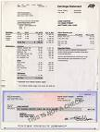
PayCheck

Slide 49
Create the UML class diagram
Paycheck

Slide 50

A Coin Purse

Slide 51
Create the UML class diagram
CoinPurse

